Slide 1
BRIDG Update
Jan., 2019 HL7 WGM
Q1 & Q2, Jan. 15, 2019
San Antonio, TX

Slide 2
Agenda
BRIDG 5.2.1 Released – quick overview
BRIDG 5.3 PSS - vote
BRIDG documentation at HL7 needs updated
NCI Cancer Ecosystem
NCI is re-designing the BRIDG website
BRIDG Implementation Best Practices Document

Slide 3
BRIDG 5.2.1 Released
Primarily ballot reconciliation for 5.2
One definition change for AnatomicPathologyReportVersion class
Also includes a new CDMH View (no new semantics, just a diagram)
Submitted to HL7 for publishing
BRIDG website – added a link for the HTML version

Slide 4
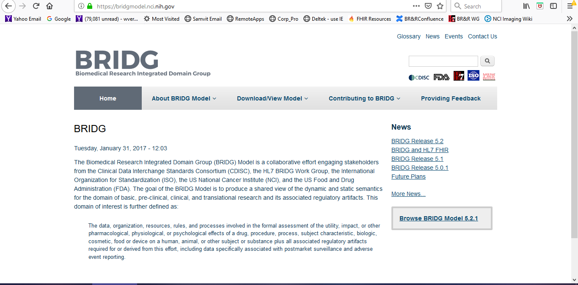
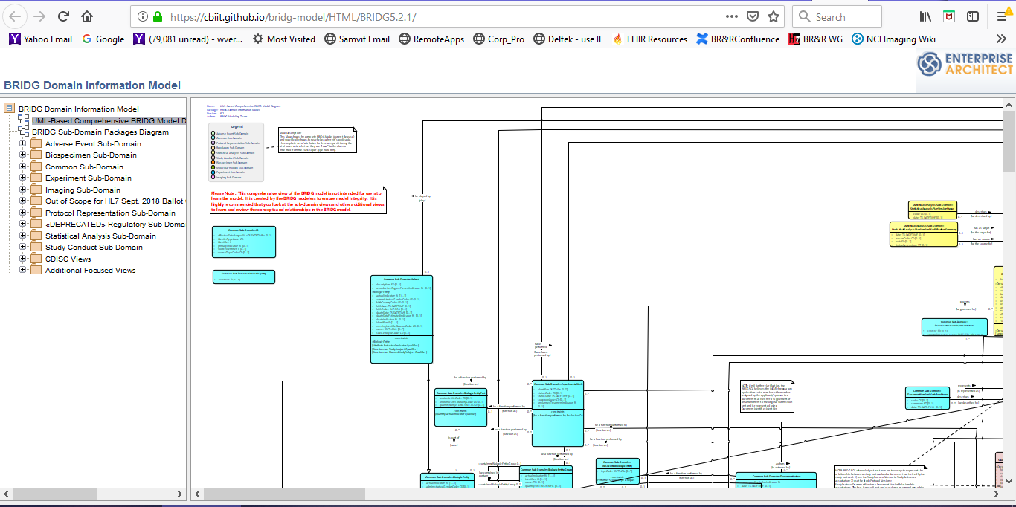
bridgmodel.nci.nih.gov

Slide 5
BRIDG 5.3 PSS Summary
VOTE
SDTM 3.2 – new domains added, existing domains updated, some domains unchanged (next slide), stats so far (80+% done):
18 BRIDG changes out of 724 rows total
4 Path support changes
501 Supported, 22 Derived, 26 Deferred (Statistics), 92 Implementation-specific
NBIA Harmonization – (overview coming up)
1 new attribute (smallest harmonization impact ever)
89 out of 463 rows Supported, 2 Derived, 5 Deferred, 300 Implementation-Specific, 63 Out-of-Scope
New views for SDTM 3.2, NBIA, some other small collections of classes, possible reorganization of model to make it more accessible and easily navigated
Review/Vote on PSS – Capture voting results: Wendy moved that PSS for BRIDG 5.3 as edited in Q1 be approved by the WG, Hugh seconded
For: 11 Against: 0 Abstained: 1

Slide 6
BRIDG 5.3 PSS: SDTM 3.2
New domains added:
DD – Death Details
EC – Exposure as Collected
HO – Healthcare Encounters
IS – Immunogenicity Specimen
MI – Microscopic Findings
MO – Morphology
PR – Procedures
RP – Reproductive System Findings
SR – Skin Response (Findings About)
SS – Subject Status
TD – Trial Disease Assessments
Existing domains with changes:
AE – Adverse Events
EG – ECG Results
EX – Exposure
MB – Microbiology Specimen
MH – Medical History
PC – Pharmacokinetics Concentrations
PP – Pharmacokinetics Parameters
SU – Substance Use
VS – Vital Signs
TV – Trial Visits
Remaining domains – updated mappings

Slide 7
BRIDG 5.3 PSS: NBIA
National Biomedical Imaging Archive
“…searchable repository of in vivo images that provides the biomedical research community, industry, and academia with access to image archives to be used in the development and validation of analytical software tools that support:
Lesion detection and classification
Accelerated diagnostic imaging decision
Quantitative imaging assessment of drug response”
48-table data dictionary, 413 columns; many correspond w/ DICOM
Comments from Ulli:
NBIA wiki including installation package, user and developer documentation https://wiki.nci.nih.gov/display/NBIA/National+Biomedical+Imaging+Archive+-+NBIA
NBIA demo instance at NCI: https://imaging.nci.nih.gov
NBIA used as core software of The Cancer Imaging Archive (TCIA) http://www.cancerimagingarchive.net/
GO BACK A FEW SLIDES, REVIEW PSS AND CAPTURE VOTE

Slide 8
Updating BRIDG Documentation at HL7
Product brief is a little out of date
Search on HL7 website for BRIDG brings up some very old documents
Want to reconcile BRIDG version numbers (e.g. 5.2.1) with HL7 release numbers (e.g. R5)
Ed and Wendy will work with Lynn Laakso to bring things up to date
Include discussion of requirement that all master documents be stored on Confluence vs bridgmodel.nci.nih.gov & github

Slide 9
NCI Cancer Ecosystem
Leveraging BRIDG for Data Commons
Comments from Ed Helton
Drivers: FDA Cures Act, Beau Biden Moonshot => Blue Ribbon Panel identified top 10 things community can do to help cure cancer, #1 was share data
Cancer data ecosystem – The Cancer Genome Atlas (TCGA) contributed to development of Genomic Data Commons (GDC) which has become the primary template for data commons of other types (under leadership of Bob Grossman) for instance…
Imaging Data Commons (IDC)
Clinical Data Commons
Cancer Biomarker Data Commons
Etc. (see graphic on following slide)

Slide 10
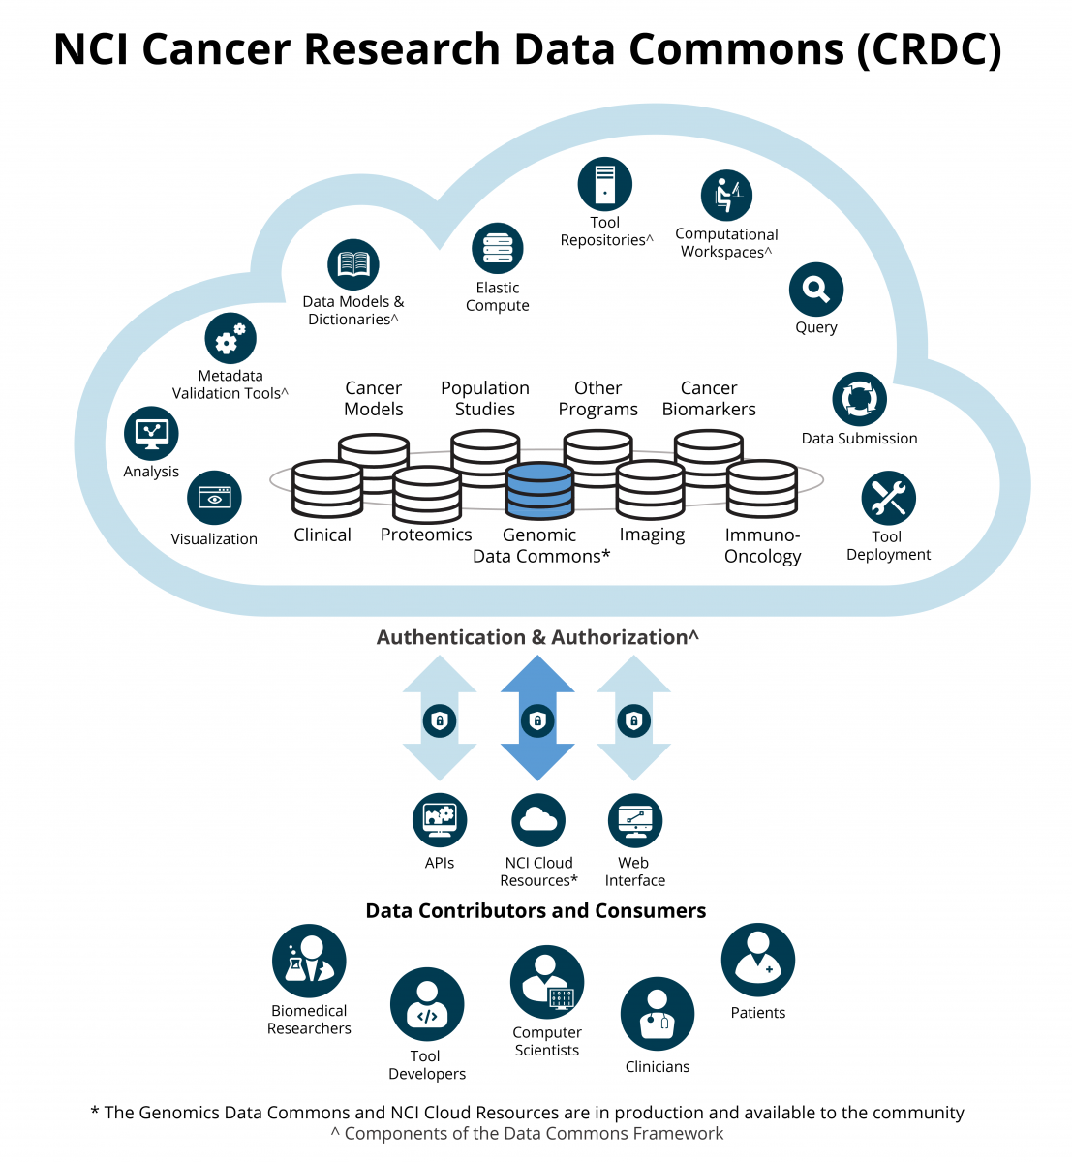
NCI Cancer Ecosystem (continued)

Slide 11
NCI Cancer Ecosystem (continued)
Data Commons Framework (DCF) – how Data Commons (DCs) work together, talk to each other
Keeps coming back to data harmonization and standardization
Have to have good clinical data as the glue to hold all DCs together
Not using the same cloud on the DCs
Semantic Architecture Resource (SAR) is in planning stage

Slide 12
BRIDG Web Site
NCI is redesigning the BRIDG website, based on:
Added HTML link on main page - DONE
NCI requirements
BRIDG Stakeholder requirements
User Requirements
Timeline is over several months
May implement sets of improvements in stages as they are ready
Key focus is on making it more usable, easier to find things

Slide 13
BRIDG Implementation Best Practices Document
NCI is writing a BRIDG implementation best practices document
Has been needed for a while, requested periodically
Will seek input from BR&R after first draft is ready
Will eventually be published on BRIDG web site
Timeline is over several months

